Slide 1
HackerEarth SIGMATHON 1.0 Hackathon
DATA ANALYSIS AND INSIGHTS PRESENTATION
PRESENTED BY
TEAM
PyFlow ++

Slide 2
INTRODUCTION
This is about the analysis made on the dataset obtained from DataCo supply chain
Supply chain analytics brings data driven intelligence to the business, reducing the overall cost to serve and to improve the service levels.
Descriptive analysis is carried out by using the data visualisation techniques like charts and graph to uncover patterns and generate insights.
On analysing this dataset, we have understood and acknowledged about consumer behaviour and marketing strategies.

Slide 3
TYPES OF ANALYSIS
The dataset includes a total of 180520 rows of customer purchase history, details, demographics spanned to 53 columns.
There were many features like total sales, profit ratio, customer segment, transaction details, customer region, order status, delivery status which are vital to determine the sales analysis.
Based on these features, we have made several type of analysis like
Monthly analysis
Market analysis
Financial analysis
Delivery analysis
Customer segment analysis
Department analysis
Shipping analysis

Slide 4
MONTHLY ANALYSIS
The sales orders received is highest during the month of July.
Total sales done and profit incurred is almost same in the month of August comparative to others.
Reasons for decline in sales maybe due to competitive market.
Price can also have a big impact on sales. High price can maximize short term profit while low price products can maximize long term profit.

Slide 5
MARKET ANALYSIS
LATAM(27.9%)
Pacific asia(22.5%)
USCA(13.8%)
Africa(6.2%)
Europe(29.6%)
Order items placed is highest in Europe(demand high).
This is because the shipment facilities are excellent in Europe and customer shave purchased more number of technological products like camera and laptop which have high budget
Order items placed is least in Africa , analyzing the cause can increase the profit per order
The order item total is low in Africa because the customers have purchased more number of low budget goods rather than high budget goods.
Hence the total amount gained by the company is low.

Slide 6
FINANCIAL ANALYSIS
There is a decrease in order item profit ratio from January 2015 to January 2018.
The profit in the year 2016 is low when compared to the other 2 years. This may be due to low sales earnings and low merchandise cost.
The data is not complete for the year 2018. Hence the graph shows a steep line, but the profit for the starting month of 2018 is also high as 2017.

Slide 7
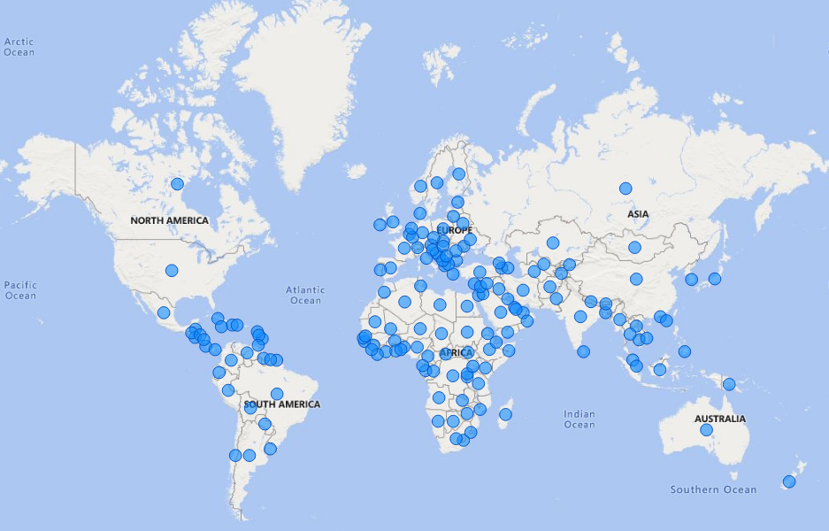
GEO MAP
This is a world chart showing the location of orders in a world map
The number of orders is high in the region of Europe followed by America and Africa.
The orders in these regions are high because of good delivery facilities and easy access to get the products ordered through online.
It indicates that there is a large customer base and global presence due to the availability of products according to customer needs.

Slide 8
MARKET ANALYSIS
Using Country and City
The TOP 10 Countries are mixed with both Developed and Developing Countries, with majority of market available in developing countries.
However, most of the cities are technically developed best cities in the world, mostly concentrated towards American and European continents.

Slide 9
CUSTOMER ORDER STATUS
Orders received among all three segments of customer is almost complete, indicating customers have increased their purchasing frequency.
This also indicates prompt execution of order.
A large number of orders are in the state of pending payment mode, the reason may be due to the issues in transaction.
Therefore we need to resolve the technical glitches so that the order status become complete .

Slide 10
REGIONAL ANALYSIS
Europe being the top region in terms of higher orders placed, risk of late delivery is equally high.
Latin America is also among the highest late delivery region.
This is due to the fact that more number of orders are placed from these regions and the shipment may get delayed due to these large number of orders.
Even though the company had large sales from these regions, the company failed to deliver the products on time for many products.
As far as customer lifetime value is concerned ,the number of orders may decreases because of late deliveries.

Slide 11
DEPARTMENT ANALYSIS
The products sold under the Fan Shop department has high demand among the customers with 46.5 %
Among the 11 departments, Book shop, Disc shop, Technology, Health & Beauty, Pet shop seem to have very low sales.
The sales can be increased by providing incentives such as offers, discounts, free shipping etc.

Slide 12
SHIPPING ANALYSIS
This is the analysis based on the shipping mode.
The standard class has more number of advanced shipping as well as late deliveries compared to other classes.
The late delivery can be minimized by implementing extreme return policies. This can be applied for same day shipping as well.

Slide 13
SHIPPING ANALYSIS
(CUSTOMER SEGMENT)
The occurrence of late delivery is higher among all the segments of customer.
The reason for more number of late deliveries are because of the geographical features and mode of shipment.
The order city and the delivery city is of long distance for many customer orders and hence the shipment is late.
If this continues over a period ,the customer retention rate of the business will be affected , hence steps need to be taken to meet customer satisfaction.

Slide 14
THANK YOU

